Slide 1
Family and community assessment
Sonia verma
Nsg/482ca
Pamela card
May 13, 2019

Slide 2
Indian community
The basis for customs is the religious system
All living things have a soul
Belief in rebirth and karma
The next birth is based on actions in the present life – encouraged to do good in order to have a second birth as a human being
Every day starts with praise directed to God
In God’s eyes, all religions and all humans are equal
Hinduism and Sikhism share many beliefs
Notes:
I interviewed an Indian family who believes in family, unity, and religion. They live in an extended family with mother, her son and his wife and the grandkids. There culture is group-oriented. Group decisions take precedence over individual decisions. The goal is always to honor the family, especially the elders in the family.
The elders in the family make the decisions related to health care treatment for all family members. The patient may not even be aware of what is being decided.
The man is the head of the family, but both parents participate in the upbringing of the children and are responsible for their children all of their lives.
In India, the family does bedside care of the patient and the nurse does not participate in this care. To clean up stool is not respected, so nursing is often not a respected profession.
Mother is elderly lady who needs help with her care. Son and daughter-in-law both work on alternate days to take care of their kids and the mother. They don’t believe in sending their kids to day care or their mother to senior care center.

Slide 3
FAMILY GENOGRAM
JF
KF
SF
AF
DF
RF
SF
Notes:
In this family genogram, I spoke with Flora family. Kartar Flora and Jatinder flora got married and had two sons, Ajitpaul Flora and Davinder Flora. JF passed away five years ago due to kidney failure and heart condition. Kartar lives with her son AF and his wife and they both have two daughters Ria and Shaina who are 10 and 6. Kartar’s younger son DF lives in San Francisco as he got a job in a company there.

Slide 4
ECOMAP
EXTENDED FAMILY SUPPORT
INDIAN COMMUNITY STRESSFUL
FLORA FAMILY
EDUCATION AND SOCIAL SUPPORT
MEDICAL AND HEALTH SERVICES
Notes:
Flora family has good family support and believe in unity. Kartar Flora’s husband came to United States after their marriage and he sponsored his wife and kids when they were 15-16 of age. She told me that they struggled a lot for the first few years because she only went to school up to grade 10. She worked in subway for almost ten years but she was able to help her kids to finish high school and send them to college. Both husband and wife worked and with family support, they bought a house. Today, she is happy and proud of the achievements that both of her sons are well educated and supporting each other in happy or sad times. She mentioned that they all have medical insurance and are utilizing the medical services for their needs. Her son Ajitpaul Indian culture and community can be stressful in some ways such as children are not allowed to make their own decisions. They need to ask for permission from their parents or elders. They have parental restrictions. He stated that it’s good in a way because due to community stress or their expectations, marriages last long. He stated that he put some restrictions on his kids but won’t be super strict as older generation used to be. AF and his wife share a nice bond with Kartar. Even, grand daughters love the grandma and they all sit together on dining table and eat meals everyday. Sheenam Flora is an LVN who takes care of the mother-in-law’s medications and treatments. She only works part-time so that she can take care of the kids and Kartar routinely. Kartar has two brothers and one sister who live in Simi Valley which is about an hour away from their home. They have close bond with them as well.

Slide 5
Health beliefs in Indian community
Illness may be a result of karma from past lives.
Cleanliness is extremely important when someone is sick.
Herbal therapy may be used and may include methi, honey and turmeric.
Methi is a green leaf similar to parsley and is added to vegetables. It is believed to be beneficial for the back, fibrous tissues, and uterine involution.
Honey is given to babies with water.
Turmeric in butter ghee heals open wounds. It is used to prevent and slow the growth of cancer. Turmeric in milk is considered to help internal wounds, such as bruising.
In India, medical services are paid for in cash; no health insurance.
People get regular vaccines, but do not have access to preventive measures and health screenings. Many women are reluctant to get mammograms or colonoscopies. They go to the doctor when they are sick.
Notes:
In my interview with Indian family, I got to know health beliefs from the mother who is very cultured and traditional. She discussed about home remedies and natural things that they use for many illnesses or sickness. She came to USA when her kids were almost the age of 15-16. She doesn’t believe in vaccinating the kids because she never got vaccinated with flu or tetanus and thinks that her kids were not vaccinated either. But now her grandkids are being vaccinated every year. I noticed that her son is having different mentality about health and is following the health customs of United States.

Slide 6
Death and dying
Patients want to die at home, with the family present. They may return to India.
Chanting, prayers and incense are used at the bedside. Special water which has been prayed over.
Cremation is preferred and the ashes may be taken to Indian rivers for the last rituals.
Inheritance goes through the sons. The parents will live with the son and not the daughter. Money will be spent on the daughter’s education.
Notes:
My patient (KF) and her son discussed about death and dying process. He stated that they don’t believe in sending the parents or elderly in nursing homes. He told me that his mother was recommended to get knee surgery 2 years ago but she refused because she didn’t want to stay in rehab center. They believe in dying at their homes will all the family present. They have always lived in joint families. Parents live with the son and daughters move out of the house after marriage. KF also told me that her husband passed away at home 5 years ago even though he was hospice. Everyone took care of him at home until his last breath.

Slide 7
Diet and nutrition
Hindus and Sikhs are strict vegetarians and may feel spiritually polluted if they eat eggs, fish, or meat. They may eat only food which they have prepared themselves to be sure that it is prepared according to religious guidelines.
Some people may add chicken or fish, so personal preferences are important to know. Wheat flour is basic and is added to the everyday diet, such as tortillas or naan.
Diets may include non-saturated fats such as butter ghee and butter.
Children are fed frequently by their parents, related to the needs of a vegetarian diet. They are encouraged to drink milk.
Usually men drink alcohol and smoke cigarettes. It is not a respected practice for women. If women drink, it would be very little.
Notes:
Flora family also talked about their diet and nutrition. KF is vegetarian but her son and grandkids eat chicken/eggs. They also have a religious practice for not to eat any meat or eggs on Tuesdays and Thursdays. Indian population mostly I know is vegetarian and they don’t eat red meats at all due to religious beliefs. This is good in a way because it helps in preventing obesity or other health issues. However, I have seen many Indian people with B12 deficiency. There are many evidence-based studies that show that infants get harmed as a result of low vitamin B12 status of the mother and this is because of widespread vegetarian food habits of Indian people. Matter of fact, KF has anemia and B12 deficiency and takes iron pills everyday.

Slide 8
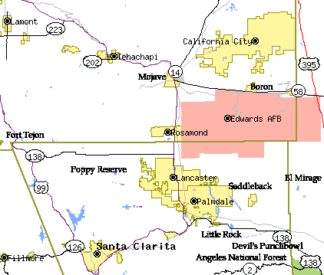
Antelope valley community assessment
Communities around Lancaster similar clinical site
No obvious separations between communities
Lancaster and Palmdale fairly similar
More houses than apartments in Palmdale
Notes:
Antelope Valley is a growing city with population of about 160,300 people as of today. Neighborhood is improving and growing as said by one of the neighbors in Palmdale. 77.00% of Lancaster Ca residents speak only English, while 23.00% speak other languages. The non-English language spoken by the largest group is Spanish, which is spoken by 18.79% of the population. The race most likely to be in poverty in Lancaster Ca is Black, with 37.62% below the poverty level.
Retrieved from: (http://worldpopulationreview.com/us-cities/lancaster-ca-population/)

Slide 9
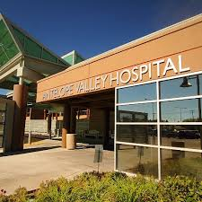
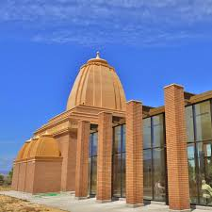
Available resources in the community
community resource, is anything that can be used to improve the quality of community life.
Educational organization
Health care organization
(Neeley, 2017).
  Religious and cultural organization
Grocery stores and food markets (Neeley, 2017).
  Religious and cultural organization
Grocery stores and food markets (Neeley, 2017).
Notes:
There are many community resources for such as temple, churches, senior day care centers, public parks, supermarkets, antelope valley mall, public library etc.

Slide 10
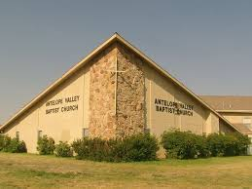
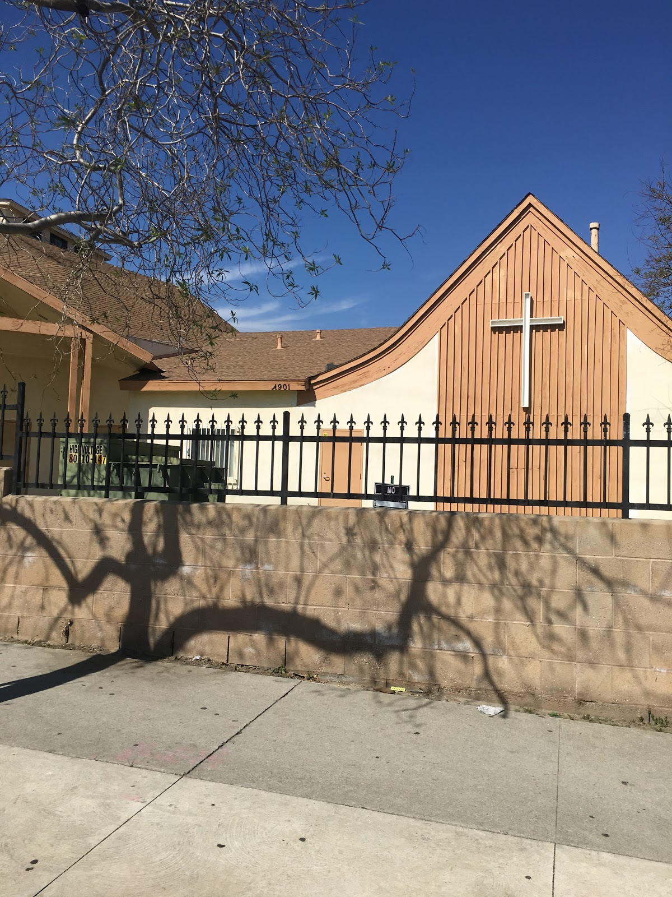
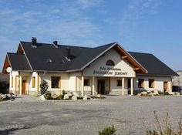
Recreational facilities
Notes:
Some pictures of the recreational or religious facilities.

Slide 11
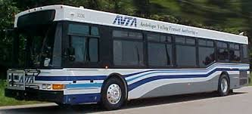
Public transportation
Antelope Valley Transit Authority
Metrolink
Notes:
The Antelope Valley Transit Authority (AVTA) local bus service takes children to school, employees to work, and residents to local stores and malls.
Rail service is available from the Antelope Valley to Santa Clarita, the San Fernando Valley and L.A. basin cities from Monday through Saturday by Metrolink.

Slide 12
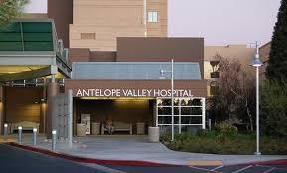
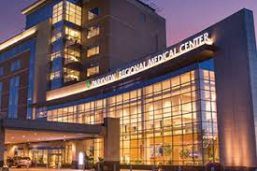
Medical facilities
Antelope valley Hospital (AVH)
Palmdale Regional Medical Center (PRMC)
Notes:
There are two big hospitals in Antelope Valley but PRMC doesn’t have all the facilities or services such as trauma, mental health, pediatrics, L&D, and NICU. So most of the population goes to AV hospital to get emergent services and that’s why AV ER is always busy. There are two urgent cares but Kaiser only sees their patients so most of the uninsured population goes to high desert medical urgent care or AVH for their illness. County hospital (Olive View Medical Center) is 60 miles away from Antelope Valley.

Slide 13
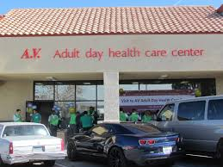
Elderly in the community
Nursing Home and rehab centers in the community:
Lancaster Health Care Center
Ellison John Transitional Care Center
Antelope Valley Day Care Center
Notes:
There are many day care centers or senior centers for elderly population in Lancaster. People from close by cities are also admitted in nursing homes in Lancaster.

Slide 14
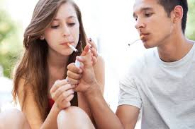
Public health problem
High risk groups at this community are teenagers
One solution could be:
  Encourage them to participate in sports activities by offering low cost classes so family be able to afford
Notes:
Alcohol abuse, Tobacco use, illicit drug use and mental health illness is very common in this community. Substance abuse causes many problems to society. These problems include harm to drug-exposed infants, automobile and workplace accidents, and reduced production in business and industry. Furthermore, there are many links between substance abuse and crime, including robbery, burglary, and theft. There are many treatment or rehab centers in Antelope Valley to help with these addictions such as Tarzana Treatment Center or Alcohol Drug Abuse Center to name a few.

Slide 15
Healthy people 2020
Decrease Obesity
Increase physical activity
Educating about balanced nutrition
Notes:
According to the Healthy People 2020, “Good nutrition, physical activity, and a healthy body weight are essential parts of a person’s overall health and well-being” (Healthy People 2020, 2013). As a public health nurse, our role would be to provide education to the community starting within the school districts to offer balanced nutritional food to the children. We should also try to get more fresh produce, such as setting up with local farmers to have a farmer’s market once a week and ask the farmer’s to discount the produce since the neighborhood with a low-income area. Another way is to get more and more public parks so that people can increase physical activity. People need to be educated to reduce fast food intake and to get their grocery from farmer’s market on low prices.
Public health nurse plays an important role in detection and prevention of illnesses in the community. What I noticed in this community is that there are over twenty fast food restaurants within the 8 mile radius. Educating the community about obesity and the risks of consuming high fat foods is a high priority in this community. Implementing a farmer’s market which would be discounted to this community would help control obesity and decrease fast food intake. Health Risks that are possible health risks include numerous fast food restaurants, limited places for physical activity (parks, gym and bike lanes), limited access to medical centers and access to alcohol stores.
There are numerous fast food establishments and limited access for the community to participate in physical activity. In order to positively affect the nutrition, physical activity, and obesity health indicator, it is imperative to implement medical screening centers and activities to reach out and educate the community on health promotion.

Slide 16


How can we keep the community safe?
We Keep the community safe by:
  Encouraging people to get to know their neighbors
  Stay current with crime trends in the area
  Improve the lights on the streets
  Observe and report any suspicious behavior
  Work with the police
Notes:
There is a city program supported by National Sheriff’s Association called ‘ Neighborhood Watch’ which embraces and strengthens many things such as watching out for each others' homes and working together to solve problems. The Neighborhood Watch groups get started because of incidents in the community that have caused concern - burglaries, acts of vandalism, auto thefts, or drug sales, for example. This program helps in reducing these types of incidents.
There are links and information for public to call or report any suspicious behaviors on cityoflancaster.org website. It gives detailed information on when, how and whom to report any incident.

Slide 17
References:
Neeley, C. K. (2017, October 03). Examples of Community Resources. Retrieved from https://pocketsense.com/examples-community-resources-5677.html
U.S. Department of Health and Human Services (2013). Nutrition, physical activity and obesity. Retrieved from http://www.healthypeople.gov/2020/LHI/nutrition.aspx

